Slide 1

TECH MAHINDRA FINAL PROJECT
BANKING APPLICATION
BY
VASA BHANU PRAKASH
SAI VENKATA RAMANA MUDA
BODDU SANDEEP

Slide 2
Project Abstract
This case study focuses on the development of a robust web application for a bank, designed to streamline operations like account management, loan processing, and customer support. The goal is to enhance customer satisfaction, ensure secure transactions, and improve operational efficiency using modern technological solutions.
Objective
To create a user-friendly, secure web application that provides comprehensive banking services, thereby improving customer experience and operational effectiveness.

Slide 3
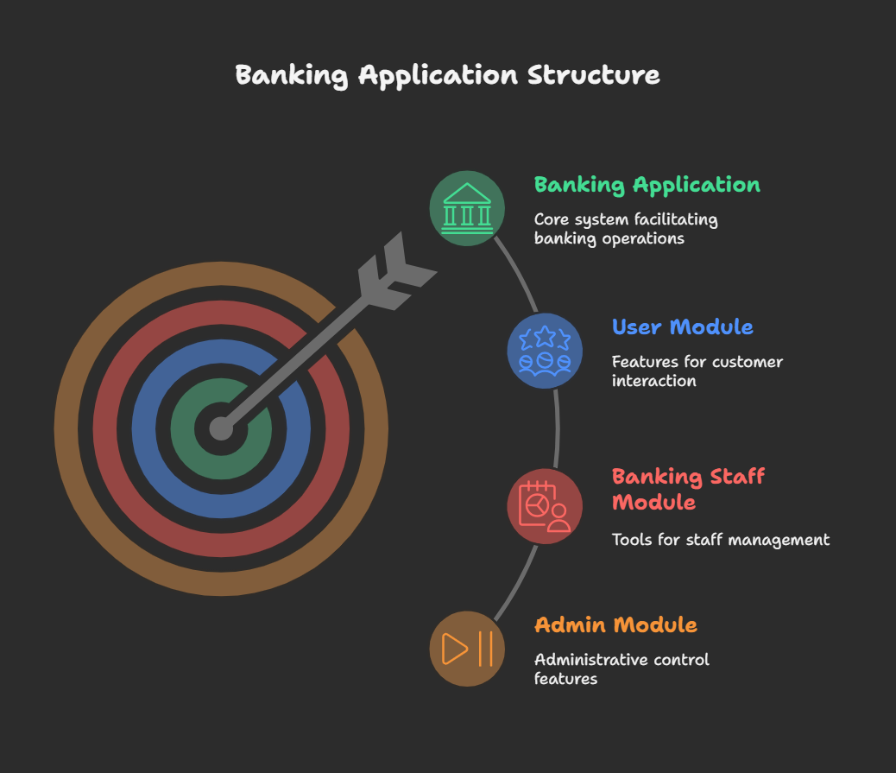

Slide 4
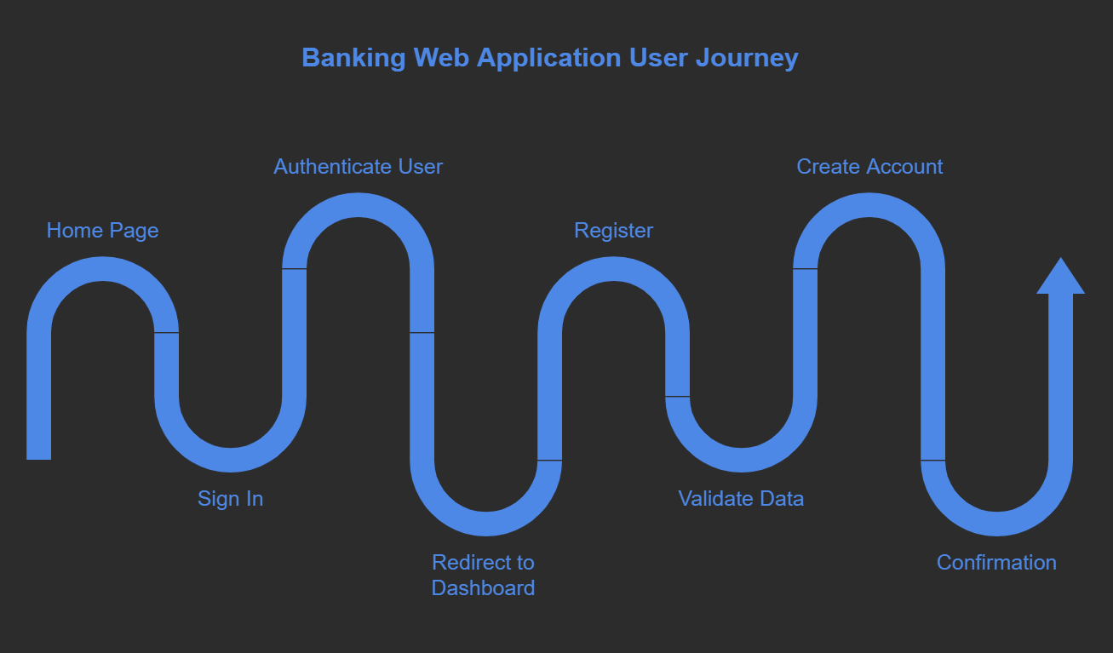

Slide 5
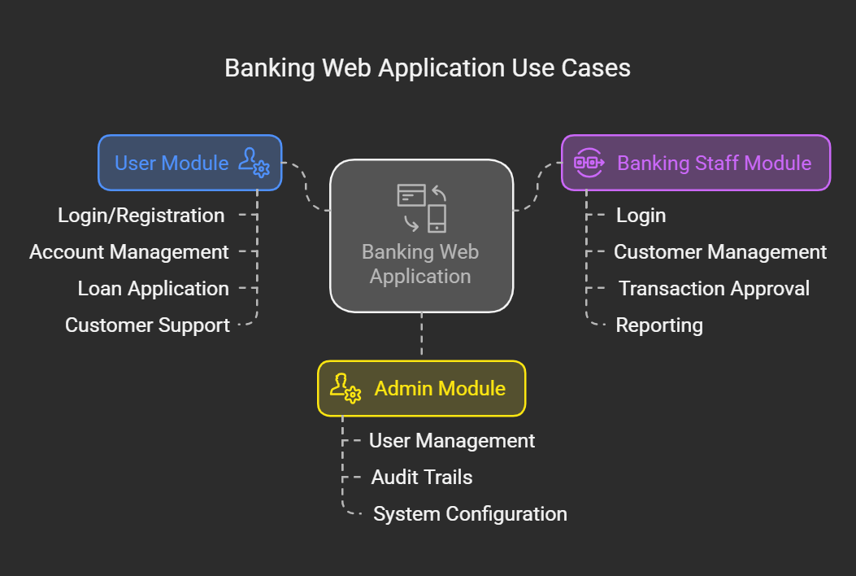

Slide 6
Technology Stack
Frontend Technologies: HTML, CSS, JavaScript, and Bootstrap for building a responsive interface.
Frontend Framework: Angular for a dynamic and efficient user experience.
Server Side Programming: Spring Boot for handling server-side logic efficiently.
Backend Frameworks: Hibernate for object-relational mapping and Spring MVC for the application framework, complemented by Spring Boot Rest for API services.
Language: Java, leveraging its robustness and scalability for enterprise-level applications.
Database: MySQL, chosen for its reliability and performance in handling complex queries and transactions.

Slide 7
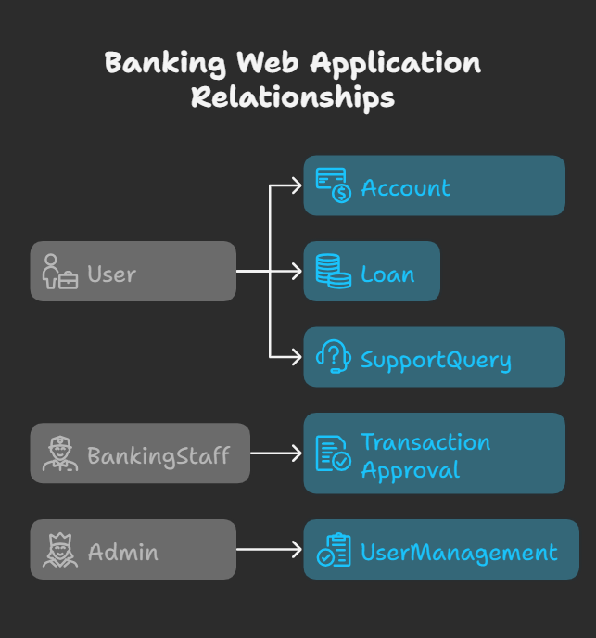

Slide 8
Conclusion
The banking web application is designed to provide a user-friendly and secure platform for managing banking operations. By implementing modern technologies and robust security features, the application aims to enhance customer experience and operational effectiveness.

